Slide 1
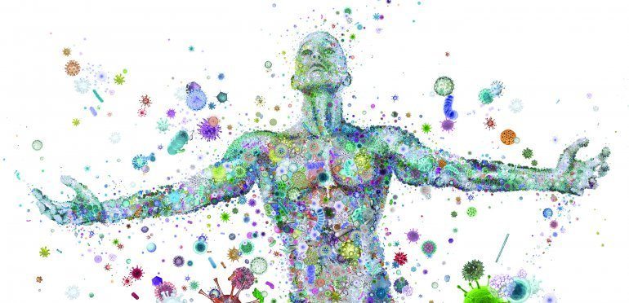
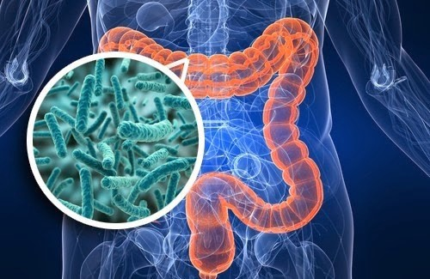
Diet and Microbiome
Future of food science and Technology
Dr. Luay Abu-Qatouseh
PHD Medical Microbiology and Immunology

Slide 2
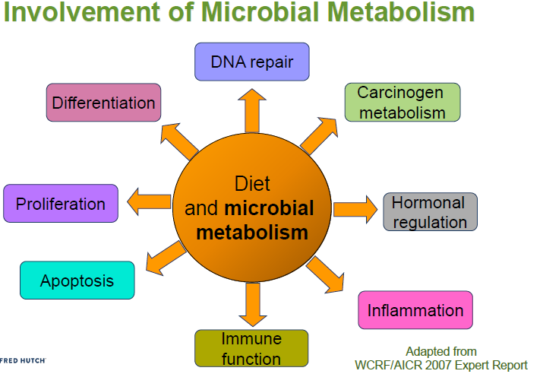
Dietary Exposures and Cellular Processes Linked to diseases

Slide 3
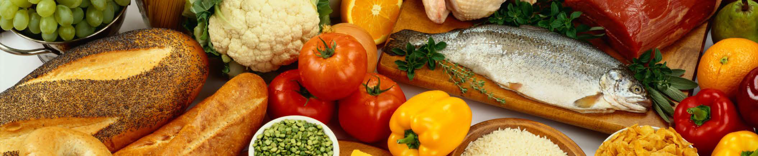
Win-Win relationship
Diet affects the gut microbial community
Gut microbiome affects components of diet

Slide 4
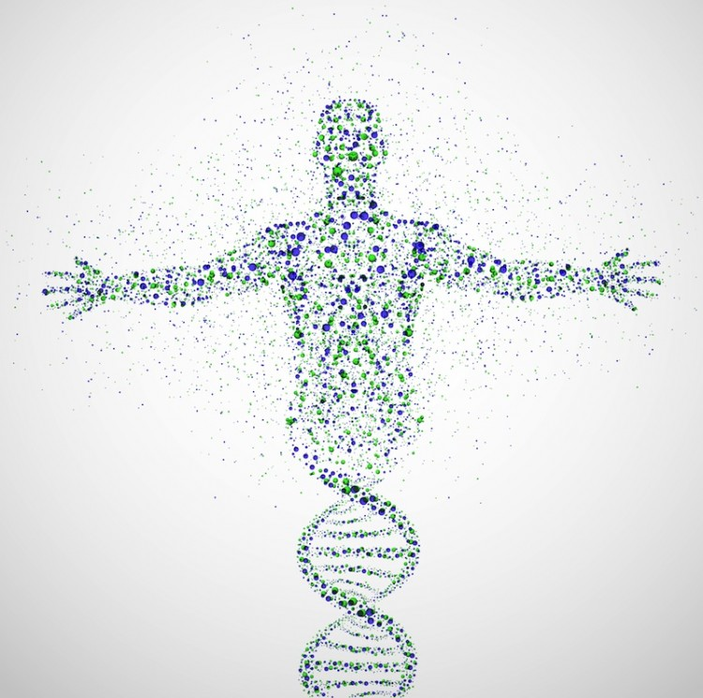
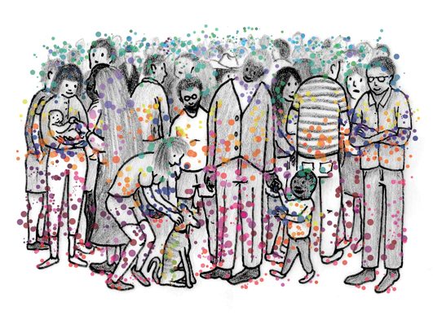
Microbiome
Your bacterial community is a fingerprint for you
Microbiome: >100 times as many genes as human genome
Carry out reactions that human gut enzymes cannot
Fermentation
Denitrification
Sulfate reduction
Aromatic fission
Hydrolysis/deconjugation

Slide 5
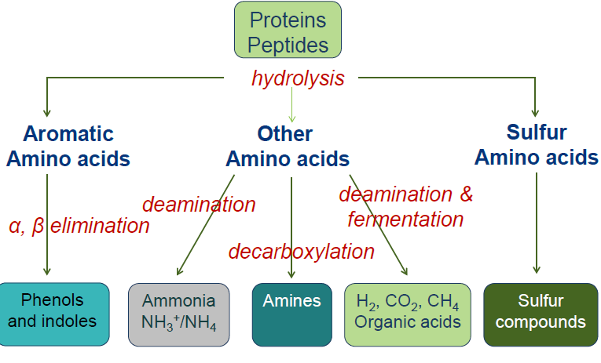
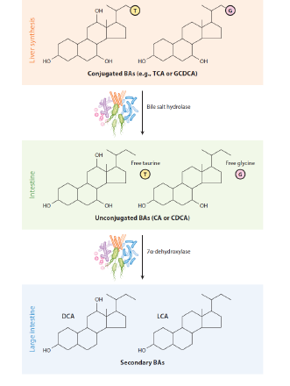
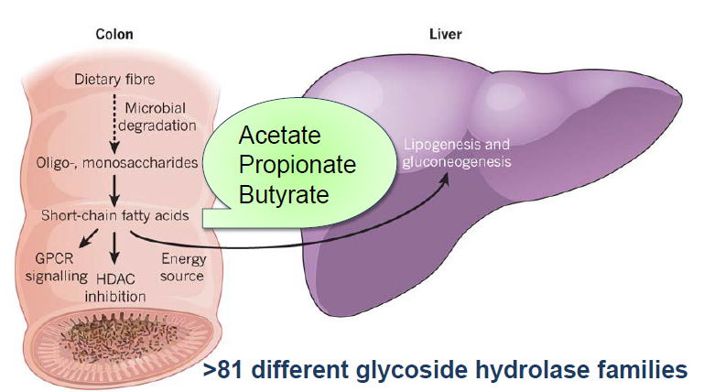

Slide 6
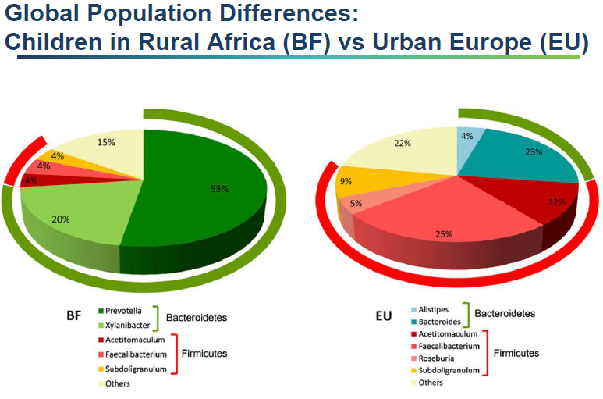
Diet type changes Microbiome

Slide 7
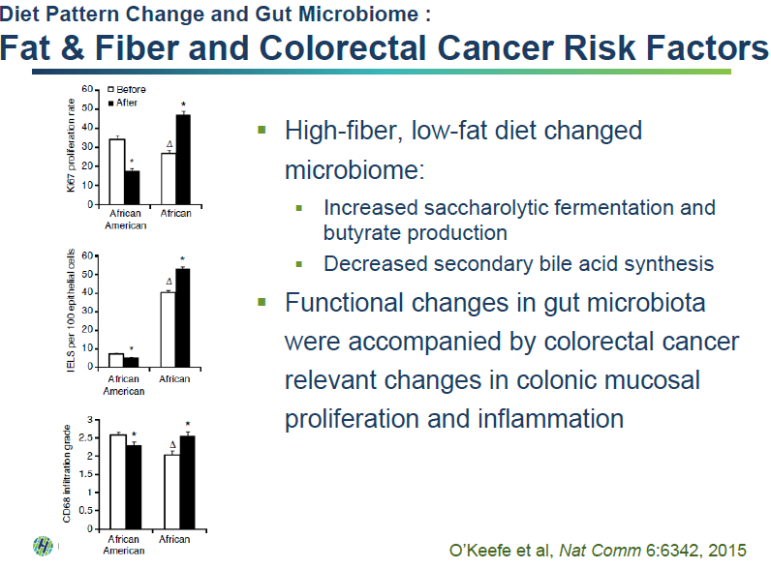

Slide 8
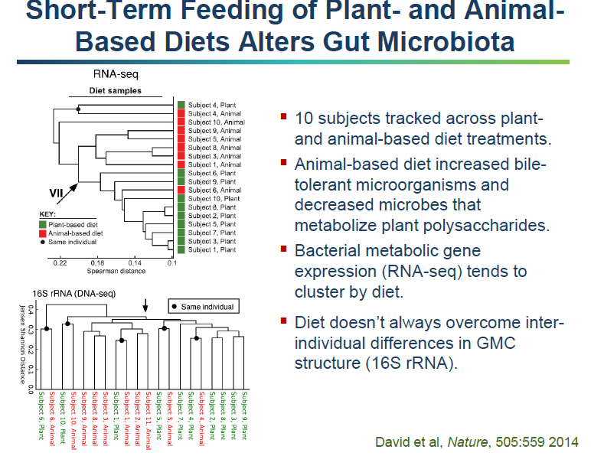

Slide 9
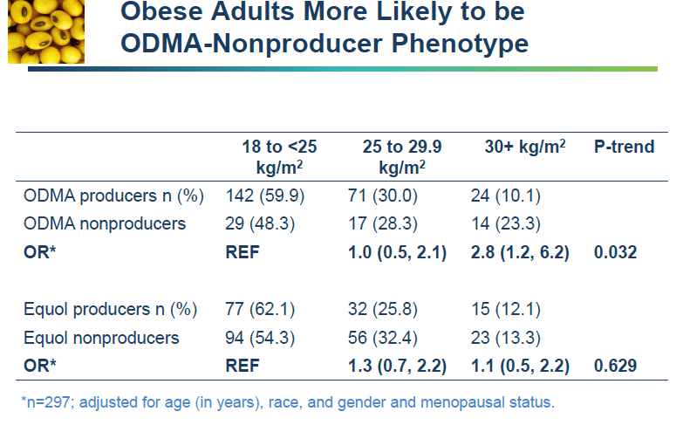

Slide 10
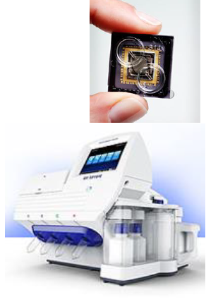
WHERE WE STAND
ADVANCE TECHNIQUES
RT-PCR
DNA SEQUENCING
MALDI-TOF
-

Slide 11
Monojo is your option
With our lab facilities, collaboration and international relations, monojo is dedicated to apply state of art technical support, knowhow transfer and well training regarding the advances in food safety and security

Slide 12
Thank you

